Slide 1


FuseMachines
Emotion Based Music Recommendation System
Convolutional Neural Networks
PRESENTATION - GROUP 13
GROUP MEMBERS | Ayush Shakya | Bibek Thapa | Saurav Thakur | Yashuv Baskota
PRESENTED ON | August 10, 2023

Slide 2
Problem Statement
Music:
Evoke wide range of emotions: happiness & joy to sadness & melancholy
Different genres of music: folk, hiphop, classical, pop → Different beats, rhythm → different sensations in brain -> soothing, exciting, vibing
Emotion based music recommendation: Recommend music that accentuates current mood/ emotion of user

Slide 3
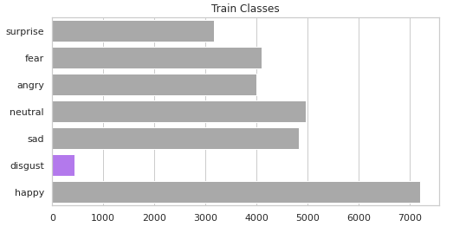
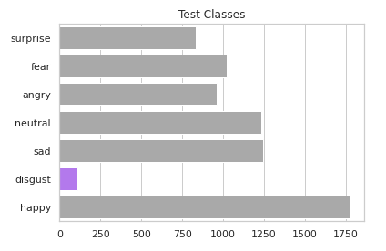
Dataset
FER-2013 Dataset:
Facial Expression Recognition Research dataset
48x48 pixel grayscale images of faces
Seven classes of emotions: Angry, Disgust, Fear, Happy, Sad, Surprise, and Neutral
Training dataset: 24,716 images
Testing dataset: 7178 images

Slide 4
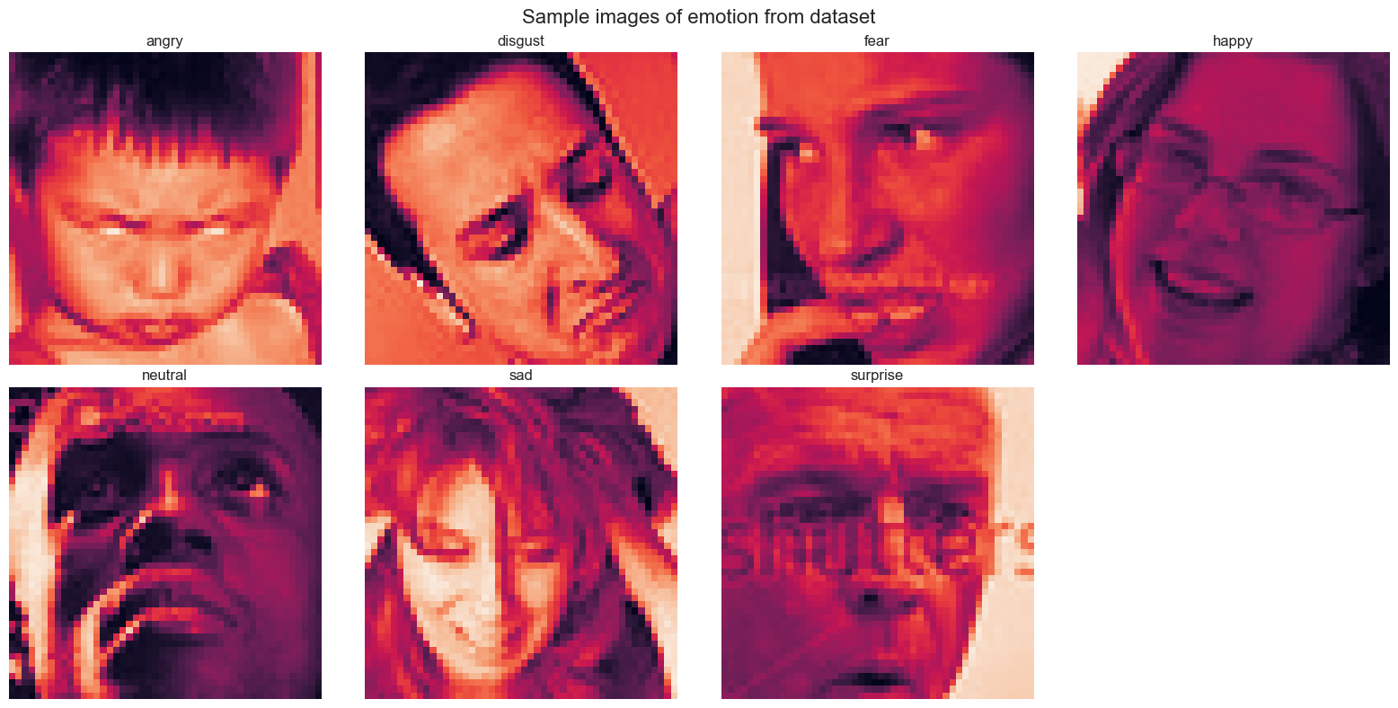
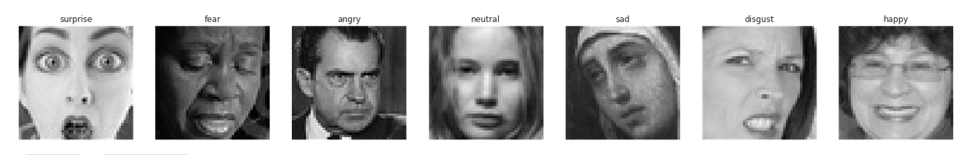
Dataset

Slide 5

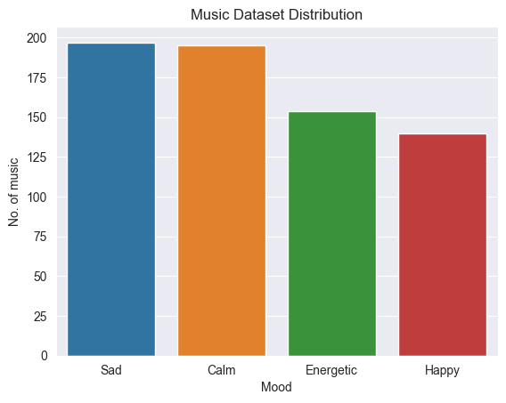
Dataset
Spotify Music Data to Identify Moods:
Music dataset sourced from Kaggle
Music recommendation component
19 columns: valuable information to identify moods associated with music

Slide 6
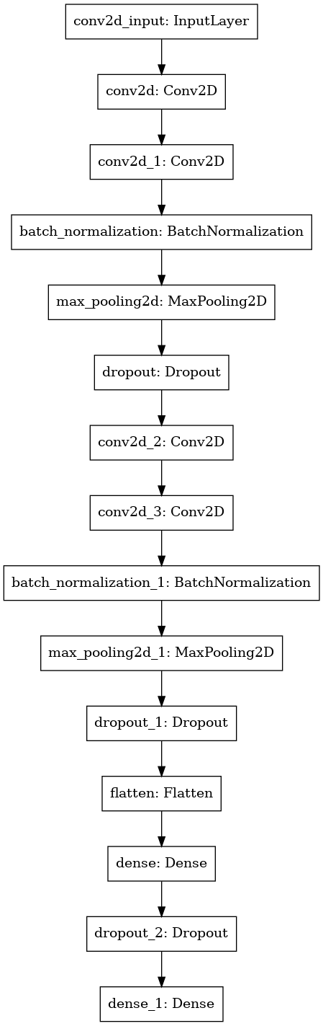
Training Model (1)
Convolutional Neural Network:
4 convolutional layers, 2 max pooling layers, 2 dropout layers, & 2 fully connected dense layers.
Input_size: (48,48,1), classes = 7

Slide 7
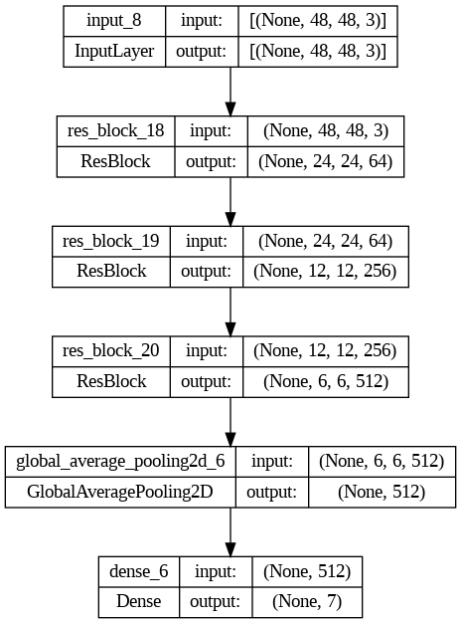
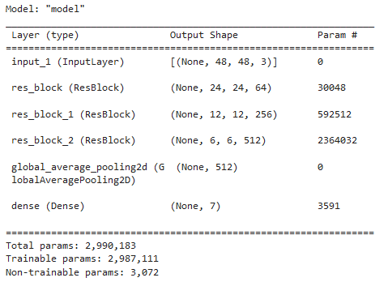
Training Model (2)
Convolutional layer

Slide 8
Training Model (3)
VGG 19
VGG19 is a variant of VGG model which in short consists of 19 layers (16 convolution layers, 3 Fully connected layer, 5 MaxPool layers and 1 SoftMax layer). There are other variants of VGG like VGG11, VGG16 and others.
Out of all pretrained models, VGG 19 performed better.

Slide 9
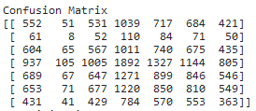
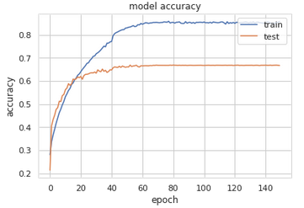
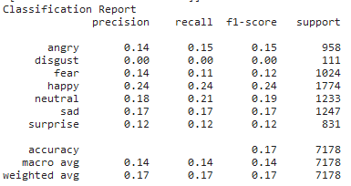
Evaluation Metrics for Model-1
Confusion Matrix:
Classification Report:
Model Accuracy Graph

Slide 10
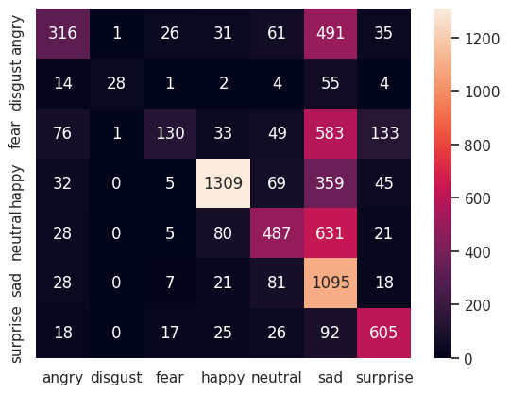
Evaluation Metrics(2)
Confusion Matrix

Slide 11
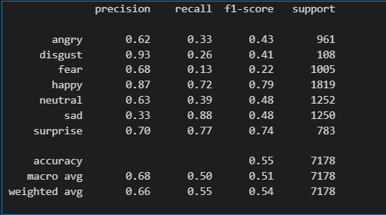
Evaluation Metrics(2)
Classification Report

Slide 12
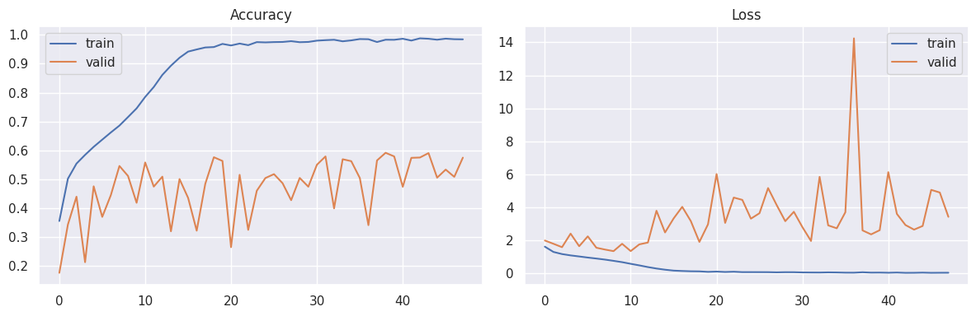
Training Metrics(2)

Slide 13
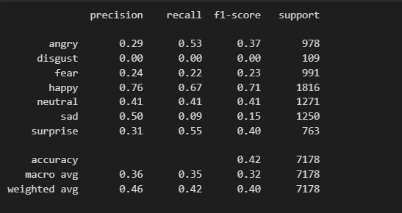
Evaluation Metrics(3)
Classification Report

Slide 14
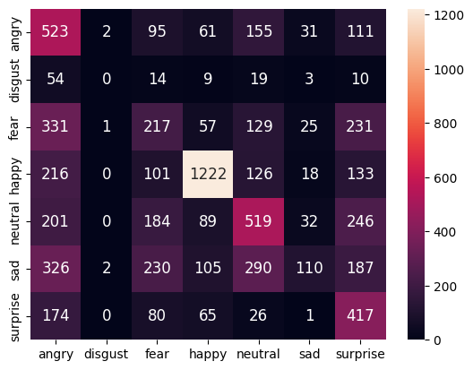
Evaluation Metrics(3)
Confusion Matrix

Slide 15
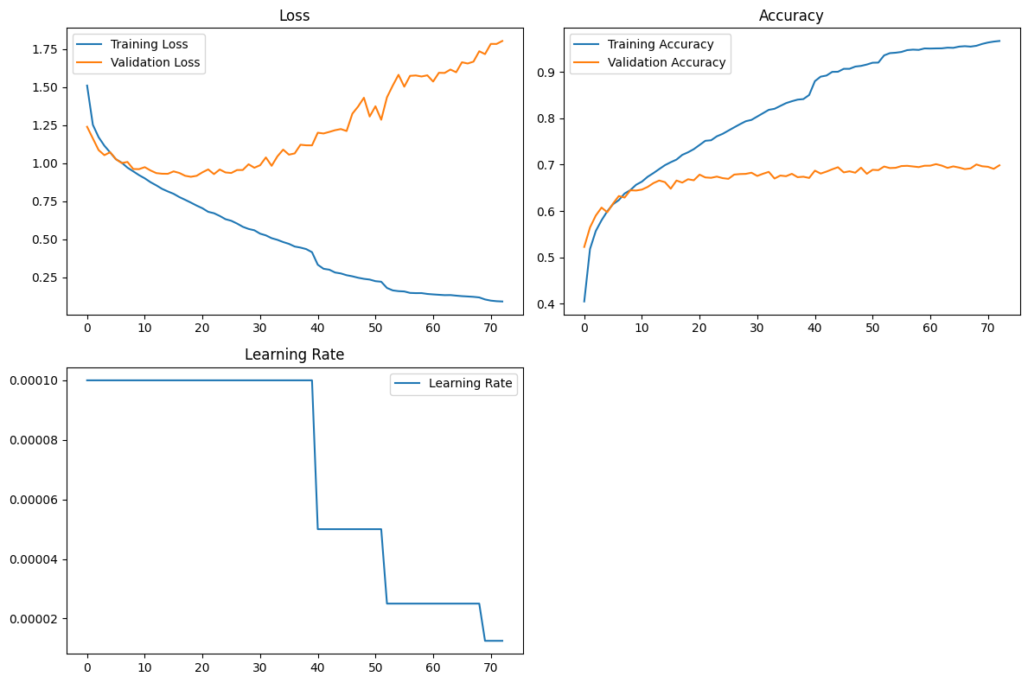
Training Metrics(3)

Slide 16
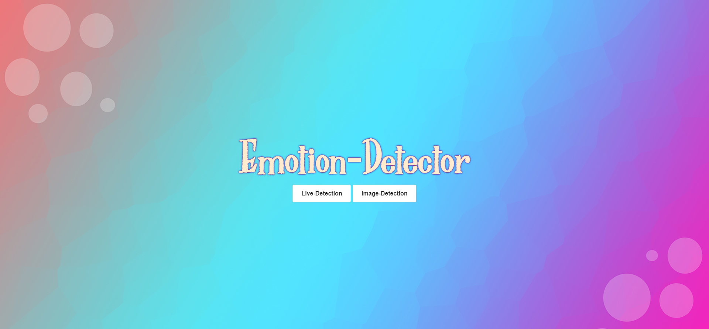
Application Interface
Flask application
Allows support for both still images and live video
Predicts emotion in image/video → Gives song recommendation

Slide 17
Demo

Slide 18
Thank You!

